Slide 1

18ECC301T – Wireless Communications
Unit IV –Improvement on Link Performance
Week 1 : Introduction to diversity, equalization and capacity, Space diversity, Scanning diversity, Maximal ratio combiner, Equal gain diversity,
Week 2: Rake Receiver, Capacity in AWGN, Capacity of flat fading channels, Equalizer and its mode, Adaptive equalizer block diagram
Week 3: Types of Equalizers - elementary level only, Introduction to MIMO antennas, Case study: Recent trends in Diversity and MIMO antenna
References :
Rappaport T.S, “Wireless Communications: Principles and Practice”, Pearson education, 2nd edition, 2009.
Andrea Goldsmith, “Wireless Communications”, Cambridge University Press, Aug 2005

Slide 2
WEEK-2
Rake Receiver, Capacity in AWGN, Capacity of flat fading channels, Equalizer and its mode, Adaptive equalizer block diagram
Courtesy:
Rappaport T.S, “Wireless Communications: Principles and Practice”, Pearson education.

Slide 3
RAKE Receiver
Powerful form of time diversity available in spread spectrum systems → CDMA
Signal is transmitted once only
attempts to collect the time-shifted versions of the original signal by providing a separate correlation receiver for each of the multipath signals.
Each correlation receiver may be adjusted in time delay, so that a microprocessor controller can cause different correlation receivers to search in different time windows for significant multipath.
The range of time delays that a particular correlator can search is called a search window

Slide 4
RAKE Receiver
If time delay between multiple signals > chip period of spreading sequence (T_{c}) → multipath signals can be considered uncorrelated (independent)
In a basic system, these delayed signals only appear as noise, since they are delayed by more than a chip duration and ignored.
Multiplying by the chip code results in noise because of the time shift.
But this can also be used to our advantage, by shifting the chip sequence to receive that delayed signal separately from the other signals.

Slide 5


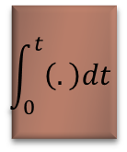



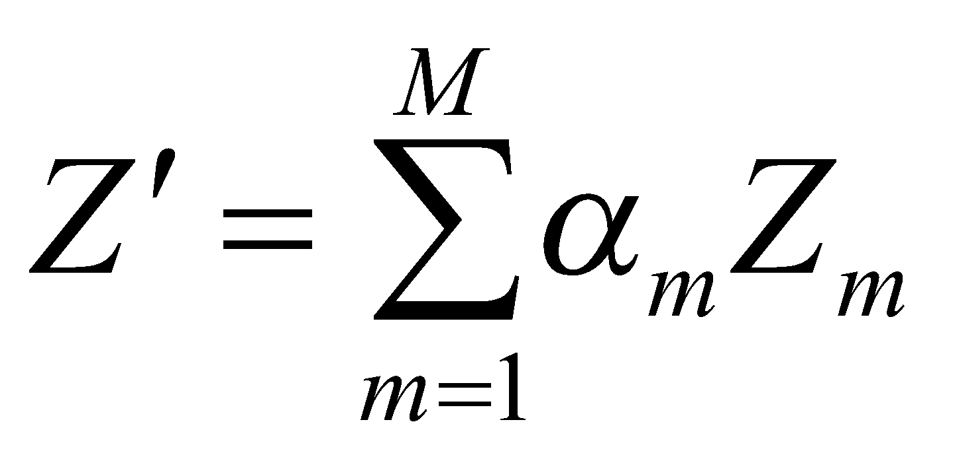
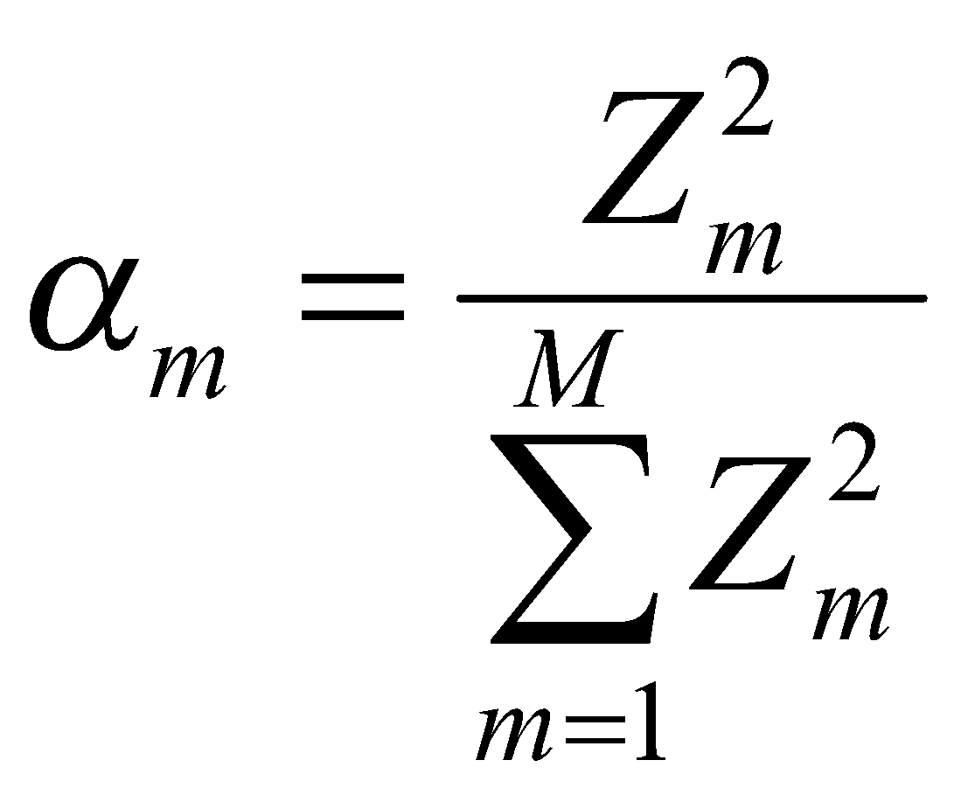
M- Branch RAKE Receiver
An M-branch or M-Finger RAKE receiver implementation
α₁
Z₁
Correlator 1
α₂
Z’
Z’
Z₂
∑
≷
Correlator 2
IF or baseband CDMA signal with multipath
α_{M}
Z_{M}
Correlator M

Slide 6
M- Branch RAKE Receiver
An M-branch or M-Finger RAKE receiver implementation
α₁
Z₁
Correlator 1
α₂
Z’
Z’
Z₂
∑
≷
Correlator 2
IF or baseband CDMA signal with multipath
α_{M}
Z_{M}
Correlator M
Each correlator detects a time shifted version of the original CDMA transmission.
Each finger of the RAKE correlates to a portion of the signal which is delayed by at least one chip in time from the other fingers.

Slide 7
RAKE Receiver
M branches or “fingers” = # of correlation Rx’s
Separately detect the M strongest signals
Weighted sum computed from M branches
faded signal → low weight
strong signal → high weight
overcomes fading of a signal in a single branch
Rake receiver is a radio receiver designed to counter the effects of multipath fading. It does this by using several “sub-receivers” called fingers, that is, several correlators each assigned to a different multipath component.

Slide 8
RAKE Receiver
In outdoor environments
the delay between multipath components is usually large
the low autocorrelation properties of a CDMA spreading sequence can assure that multipath components will appear nearly uncorrelated with each other.
In indoor environments
RAKE receiver in IS-95 CDMA – poor performance
Coz the multipath delay spreads in indoor channels (≈100 ns) which is much smaller than an IS-95 chip duration (≈ 800 ns).
In such cases, a RAKE will not work since multipath cannot be resolved
Rayleigh flat-fading typically occurs within a single chip period

Slide 9
Interleaving
Used to Obtain time diversity without adding any overhead.
Used in digital speech coders – wide range of voices in a uniform and efficient digital format.
. Two forms of Interleaver
a block structure
a convolutional structure – ideally suited for use with convolutional codes.

Slide 10
Interleaving
Used to Obtain time diversity without adding any overhead.
Used in digital speech coders – wide range of voices in a uniform and efficient digital format.
Interleaving’s only disadvantage is additional latency –receive the entire block of coded bits before they can be put in order and decoded (and then converted into an audio signal, for example). For different applications, latency requirements are different.
Voice communications are typically the most latency-sensitive, and even cell phone voice data is interleaved.
The disadvantage is that temporal correlation can be very long for most applications, even for vehicular communications.
Packet retransmissions (e.g., TCP) can be viewed as time diversity.

Slide 11
Interleaving
Problem
Errors in wireless channels occur in bursts due to fast fades
Error correction codes designed to combat random errors in the code words
Interleaving Idea
If the errors can be spread over many codewords they can be corrected- achieved my shuffling codewords
makes the channel memoryless and enables coding schemes to perform in fading channels.
the penalty is the delay in receiving information- bits have to be buffered for interleaving
Interleaving is performed after coding – at receiver deinterleave before decoding

Slide 12
Interleaving
A block interleaver is an array with d rows and n columns.
For block interleavers designed for an (n, k) block code, codewords are read into the interleaver by rows so that each row contains an (n, k) codeword.
The interleaver contents are read out by columns into the modulator for subsequent transmission over the channel.
During transmission codeword symbols in the same
codeword are separated by d − 1 other symbols, so symbols in the same codeword experience approximately independent fading if their separation in time is greater than the channel coherence time: i.e. if
dT_{s} > T_{c} ≈ 1/B_{d}, where T_{s} is the codeword symbol duration, T_{c} is the channel coherence time, and B_{d} is the channel Doppler.

Slide 13
Interleaving
An interleaver is called a deep interleaver, if the condition dT_{s} > T_{c} is satisfied.
The deinterleaver is an array identical to the interleaver.
Bits are read into the deinterleaver from the demodulator by column so that each row of the deinterleaver contains a codeword (whose bits have been corrupted by the channel.)
The deinterleaver output is read into the decoder by rows, i.e. one codeword at a time.

Slide 14
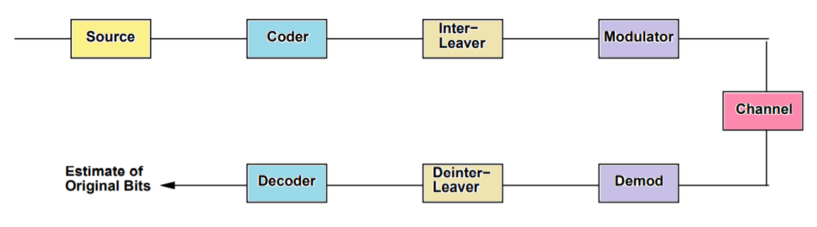
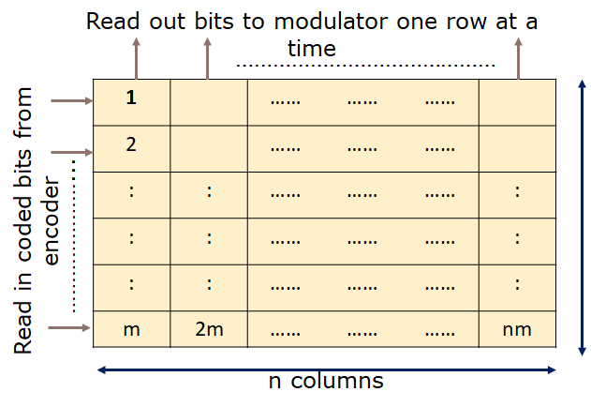
Interleaving

Slide 15
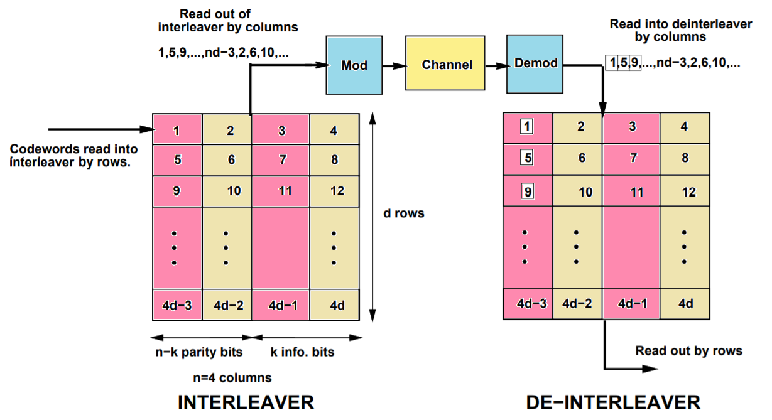
Interleaving

Slide 16
Self Test
Frequency diversity is implemented by transmitting information on more than one ___________
a) Carrier frequency b) Amplitude
c) Phase d) Modulation scheme
Frequency diversity uses ________ as a diversity element.
a) Correlation coefficient b) Coherence time
c) Coherence bandwidth d) SNR
Frequency diversity is good for low traffic conditions.
a) True b) False
Time diversity repeatedly transmits information at time spacings that exceed ___________
a) Coherence bandwidth b) Dwell time
c) Run time d) Coherence time

Slide 17
Self Test
RAKE receiver is used for _______ technique.
a) CDMA b) TDMA
c) FDMA d) OFDMA
RAKE receiver uses __________
a) Equalization b) Channel coding
c) Diversity d) Encryption
In a RAKE receiver, if the output from one correlator is corrupted by fading, all the other correlator’s output are also corrupted..
a) True b) False
Interleaving is used to obtain ___________ diversity.
a) Time b) Frequency
c) Polarization d) Antenna

Slide 18
Capacity of Wireless Channel
Introduction
The growing demand for wireless communication makes it important to determine the capacity limits of these channels.
These capacity limits dictate the maximum data rates that can be achieved without any constraints on delay or complexity of the encoder and decoder.
Channel capacity was pioneered by Claude Shannon in the late 1940s, where he developed a mathematical theory of communication based on the notion of mutual information between the input and output of a channel .
Shannon defined capacity as the mutual information maximized over all possible input distributions.

Slide 19
Capacity in AWGN
Wireless Channel typically exhibit flat or frequency-selective fading.
Consider a discrete-time additive white Gaussian noise (AWGN) channel with channel input/output relationship
y[i] = x[i] + n[i],
where x[i] is the channel input at time i,
y[i] is the corresponding channel output, and
n[i] is a white Gaussian noise random process.
Assume a channel bandwidth B and transmit power S.
The channel SNR, the power in x[i] divided by the power in n[i], is constant and given by γ = S/(N₀B),
where N₀ is the power spectral density of the noise.

Slide 20
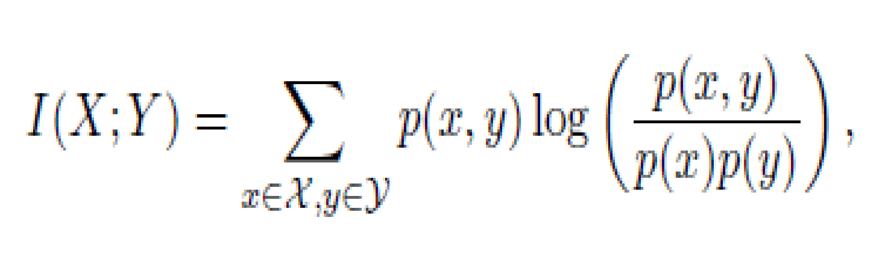
Capacity in AWGN
The capacity of this channel is given by Shannon’s formula
C = B log₂(1 + γ)
where the capacity units are bits/second (bps).
Shannon’s coding theorem - a code exists that achieves data rates arbitrarily close to capacity with arbitrarily small probability of bit error.
The converse theorem - any code with rate R > C has a probability of error bounded away from zero.
The theorems are proved using the concept of mutual information between the input and output of a channel.
For a memoryless time-invariant channel with random input x and random output y, the channel’s mutual information is defined as

Slide 21
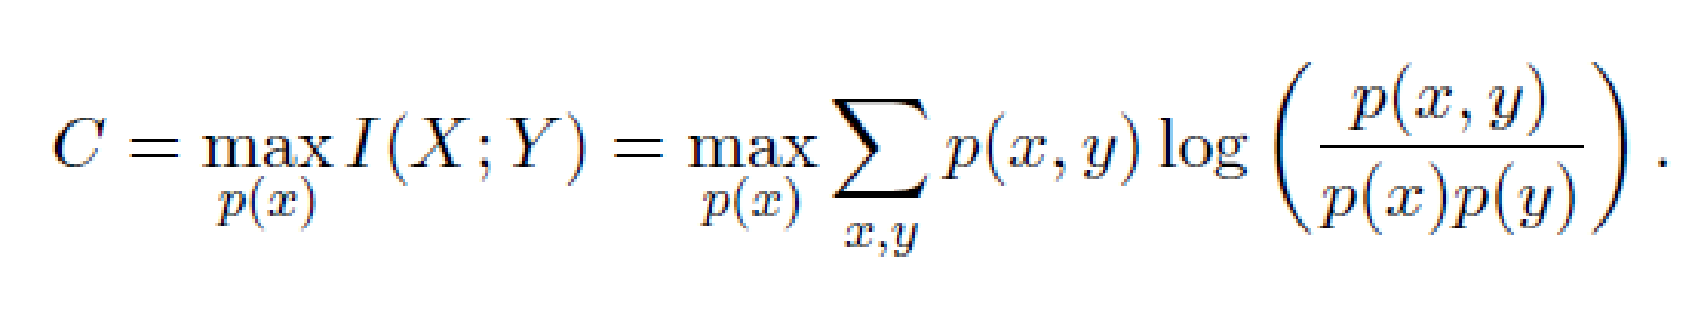
Capacity in AWGN
Shannon proved that channel capacity equals the mutual information of the channel maximized over all possible input distributions:
For the AWGN channel, the maximizing input distribution is Gaussian, which results in the channel capacity given by
C = B log₂(1 + γ)

Slide 22
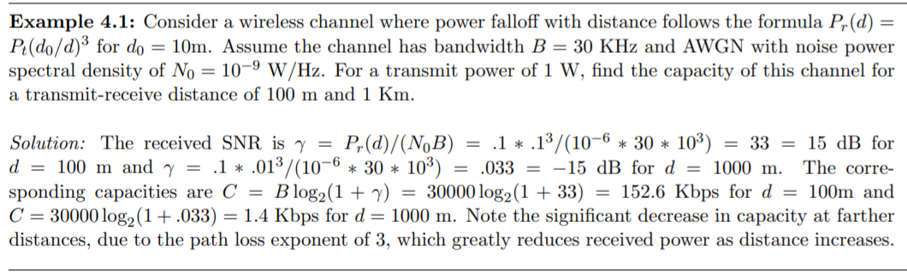
Capacity in AWGN
Exercise
Reference: Andrea Goldsmith, “Wireless Communications”, Cambridge University Press, Aug 2005, pp.102,ch.4

Slide 23
Flat Fading Channel Capacity
Flat-fading channel capacity where only the fading distribution is known at the transmitter and receiver.
Capacity under this assumption is typically very difficult to determine, and is only Known in a few special cases.
Capacity is estimated - when the channel fade level is known at the receiver only (via receiver estimation) or that the channel fade level is known at both the transmitter and the receiver (via receiver estimation and transmitter feedback).
Fading channel capacity with channel side information at both the transmitter and receiver is achieved when the transmitter adapts its power, data rate, and coding scheme to the channel variation.
The optimal power allocation in this case is a “water-filling” in time, where power and data rate are increased when channel conditions are favourable and decreased when channel conditions are not favourable.

Slide 24
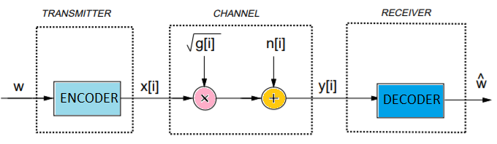
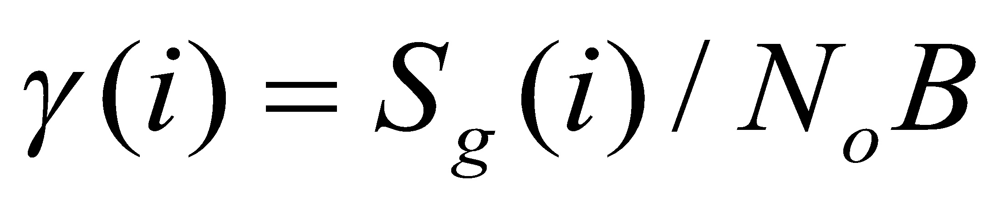

Capacity of Flat Fading Channels
Channel and System Model
Consider a discrete-time channel with stationary and ergodic time-varying gain and AWGN.
Let, S denote the average transmit signal power,
N₀ denote the noise spectral density of n[i],
B denote the received signal bandwidth.
The instantaneous received signal-to noise ratio (SNR) is then
Its expected value over all time is
is constant , the distribution of g[i] determines the distribution of γ[i] and vice versa.
Flat fading channel and System Model

Slide 25
Capacity of Flat Fading Channels
Channel and System Model
In System Model, the input message w is sent from the transmitter to the receiver.
The message is encoded into the codeword x, which is transmitted over the time-varying channel as x[i] at time i.
The channel gain g[i], also called the channel side information (CSI), changes during the transmission of the codeword.
Flat fading channel and System Model
The capacity of this channel depends on what is known about g[i] at the transmitter and receiver.

Slide 26
Capacity of Flat Fading Channels
Different Scenarios
Channel Distribution Information (CDI): The distribution of g[i] is known to the transmitter and receiver.
Receiver CSI: The value of g[i] is known at the receiver at time i, and both the transmitter and receiver know the distribution of g[i].
Transmitter and Receiver CSI: The value of g[i] is known at the transmitter and receiver at time i, and both the transmitter and receiver know the distribution of g[i].
Transmitter and receiver CSI allow the transmitter to adapt both its power and rate to the channel gain at time i, and leads to the highest capacity of the three scenarios.
The instantaneous SNR γ[i] is just g[i] multiplied by the constant S/(N₀B), known CSI or CDI about g[i] yields the same information about γ[i].

Slide 27
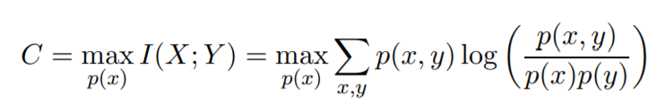
Channel Distribution Information (CDI)
Consider the case where the channel gain distribution p(g) or, equivalently, the distribution of SNR p(ϒ) is known to the transmitter and receiver.
For i.i.d. (both independent and identically distributed) fading the capacity is given by
solving this equation for the capacity-achieving input distribution, can be quite complicated depending on the fading distribution.
Fading correlation introduces channel memory, in which case the capacity-achieving input distribution is found by optimized over input blocks, which makes finding the solution even more difficult.
For these reasons, finding the capacity-achieving input distribution and corresponding capacity of fading channels under CDI remains an open problem for almost all channel distributions.

Slide 28
Channel Distribution Information (CDI)
The capacity-achieving input distribution and corresponding fading channel capacity under CDI is known for two specific models of interest:
i.i.d. Rayleigh fading channels
Finite State Markov Channels.
In i.i.d. Rayleigh fading, the channel power gain is exponential and changes independently with each channel use.
This optimal distribution and its corresponding capacity must be found numerically.
For flat-fading channels that are not necessarily Rayleigh or i.i.d. upper and lower bounds on capacity and these bounds are tight at high SNRs.

Slide 29
Channel Distribution Information (CDI)
Finite State Markov Channel
Approximates the fading correlation as a Markov process, for fading channels
The Markov nature of the fading dictates : that the fading at a given time depends only on fading at the previous time sample, it turns out that the receiver must decode all past channel outputs jointly with the current output for optimal (i.e. capacity achieving) decoding.
This significantly complicates capacity analysis.
Channel capacity in both cases depends on the limiting distribution of the channel conditioned on all past inputs and outputs, which can be computed recursively.
i.i.d. Rayleigh Fading Channel,
The complexity of the capacity analysis along with the final result for this relatively simple fading model is very high, indicating the difficulty of obtaining the capacity and related design insights into channels when only CDI is available.

Slide 30
Channel Side Information at Receiver
Channel Side Information -
We now consider the case where the CSI g[i] is known at the receiver at time i.
Equivalently, γ[i] is known at the receiver at time i.
We also assume that both the transmitter and receiver know the distribution of g[i].
Two channel capacity definitions that are relevant to system design:
Shannon capacity, also called ergodic capacity
Capacity with outage.
As for the AWGN channel, Shannon capacity defines the maximum data rate that can be sent over the channel with asymptotically small error probability.
Note that for Shannon capacity the rate transmitted over the channel is constant: the transmitter cannot adapt its transmission strategy relative to the CSI.
Thus, poor channel states typically reduce Shannon capacity since the transmission strategy must incorporate the effect of these poor states.

Slide 31
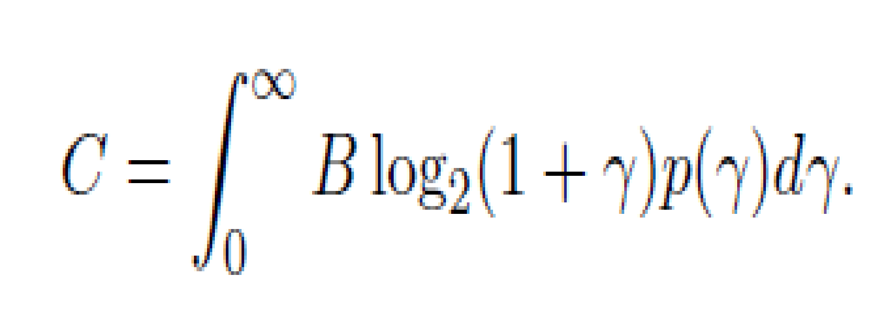
Channel Side Information at Receiver
Shannon (Ergodic) Capacity
Shannon capacity of a fading channel with receiver CSI for an average power constraint P can be obtained as
This formula is a probabilistic average, i.e. Shannon capacity is equal to Shannon capacity for an AWGN channel with SNR γ, given by B log₂(1 + γ), averaged over the distribution of γ. That is why Shannon capacity is also called ergodic capacity.

Slide 32
Channel Side Information at Receiver
Shannon (Ergodic) Capacity
The capacity-achieving code must be sufficiently long so that a received code word is affected by all possible fading states. This can result in significant delay. By Jensen’s inequality,
where γ is the average SNR on the channel.
The Shannon capacity of a fading channel with receiver CSI only is less than the Shannon capacity of an AWGN channel with the same average SNR.
Fading reduces Shannon capacity when only the receiver has CSI.
Without transmitter CSI,
the code design must incorporate the channel correlation statistics
the complexity of the maximum likelihood decoder will be proportional to the channel decorrelation time.
if the receiver CSI is not perfect, capacity can be significantly decreased

Slide 33

Equalization
❑Equalization is a technique used to combat inter symbol interference(ISI).
An Equalizer within a receiver compensates for the average range of expected channel amplitude and delay characteristics.
Equalizers must be adaptive as the channel is generally unknown and time varying.
❑ISI has been recognized as the major obstacle to high speed data transmission over mobile radio channels.

Slide 34
Fundamentals of Equalization
Intersymbol Interference (ISI) is caused by multipath
results in signal distortion
occurs in time dispersive, frequency selective fading
(bandlimited) channels
Equalization is a method of overcoming ISI
broadly refers to any signal processing that minimizes ISI
adaptive equalizers can cancel interference & provide diversity
- mobile fading channel is random & time varying
- adaptive equalizers track time varying channel characteristics
Adaptive Equalizers have two Operating Modes:
(1) training
(2) tracking

Slide 35
(1) training adaptive equalizer
i. send training sequence of known fixed-length & bit pattern
typically a pseudo random binary signal
designed to permit acquisition of filter coefficients in worst case
e.g. maximum velocity, deepest fades, longest time delays
ii. receiver’s equalizer recovers training sequence
adapts settings to minimize BER
recursive algorithm evaluates channel & estimates filter coefficients
filter compensates for multipath in the channel
iii. convergence: training obtains near optimal filter coefficients
time duration (delay) to achieve convergence depends on
equalizing algorithm used
equalizer structure
multipath channel’s time rate of change

Slide 36
(2) tracking in an adaptive equalizer
continually track and adjust filter coefficients as data is received
adjustments compensate for time-varying channel
data can be encoded (channel coded) for better performance
periodic retraining required to maintain effective ISI cancellation
effective when user data is segmented into short blocks (time-slots)
TDMA systems use short time-slots 🡪 well suited for equalizers
training sequence usually sent at start of each short block
training sequence is not changed

Slide 37
Implementation of equalizers is usually at baseband or IF
baseband complex envelope expression can be used to represent
bandpass waveforms
channel response
demodulated signal
adaptive equalizer algorithms usually simulated & implemented at
baseband

Slide 38
Communication System with Adaptive Equalizer
f(t) | combined complex baseband impulse response of transmitter, channel, & receiver’s RF/IF sections
h_{eq}(t) | impulse response of equalizer
x(t) | initial base band signal
y(t) | input to equalizer
n_{b}(t) | baseband noise at equalizer input
e(t) | equalizer prediction error
d(t) | reconstructed data
 | equalizer output
ˆ
t
d
(
)
ˆ
t
x(t)
detector-
matched filter
y(t)
Equalizer
h_{eq}(t)
d
(
)
d(t)
Σ
decision
maker
f(t)
modulator
n_{b}(t)
-
IF stage
e(t)
Σ
+
transmitter
RF
Channel
RF Front End
MAI, ISI, EMI

Slide 39
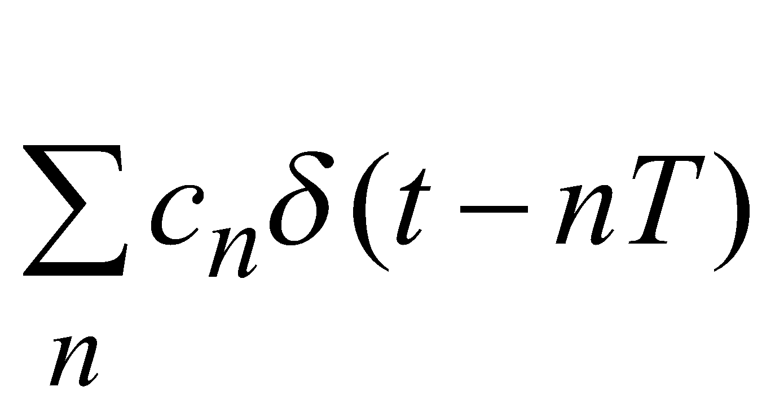
Equalizer input:
y(t) = x(t) * f*(t) + n_{b}(t)
7.1
Equalizer output:
ˆ
= x(t) * f*(t) * h_{eq}(t) + n_{b}(t) * h_{eq}(t)
7.2
d
(
t
)
= x(t) * g(t) + n_{b}(t) * h_{eq}(t)
where g(t) = combined response of f(t) & h_{eq}(t)
assume n_{b}(t) = 0 🡪
goal: force to equal x(t), the desired output
ˆ
d
(
t
)
this requires g(t) to be:
g(t) = f*(t) * h_{eq}(t) =δ (t)
7.4
complex baseband impulse response of transversal filter equalizer
given by:
h_{eq}(t) =
7.3
c_{n} = complex coefficients of equalizer

Slide 40
Frequency Domain expression of
g(t) = f*(t) * h_{eq}(t) =δ (t)
7.4
H_{eq}(f)F*(-f) = 1
7.5
Equalizers Goal is to satisfy 7.4 & 7.5
makes combined transmitter, channel, receiver ≈ all-pass channel
Thus ideal equalizer is inverse filter of channel transfer function
provides flat composite received response with linear phase response
for time varying channel 🡪 7.5 can be approximately satisfied
for frequency selective channel it is required to
- amplify frequency components with small amplitudes
- attenuate frequency components with large amplitudes

Slide 41
Survey of Equalization Techniques
ˆ
decision making device generally processes, , an analog equalizer
output
device determines the value of d(t), the incoming digital bit stream
to determine d(t), device applies either
- slicing operation
- threshold operation (non-linear operation)
d
(
t
)
linear equalizer: d(t) isn’t used in equalizers adaptive feedback
non-linear equalizer: d(t) is used in feedback path
many filter structures are used in equalizer implementation
for each structure, there are numerous algorithms used to adapt
equalizer

Slide 42
types
structures
adaptive
algorithm
equalizer
linear
non-linear
DFE
ML symbol
detector
MLSE
Transversal
Channel
Estimator
transversal
lattice
transveral
lattice
0-forcing,
LMS, RLS
Fast RLS,
Sq. Root RLS
LMS, RLS,
Fast RLS
Sq. Roor RLS
LMS, RLS,
Fast RLS
Sq. Roor RLS
Gradient RLS
Gradient RLS

